Slide 1
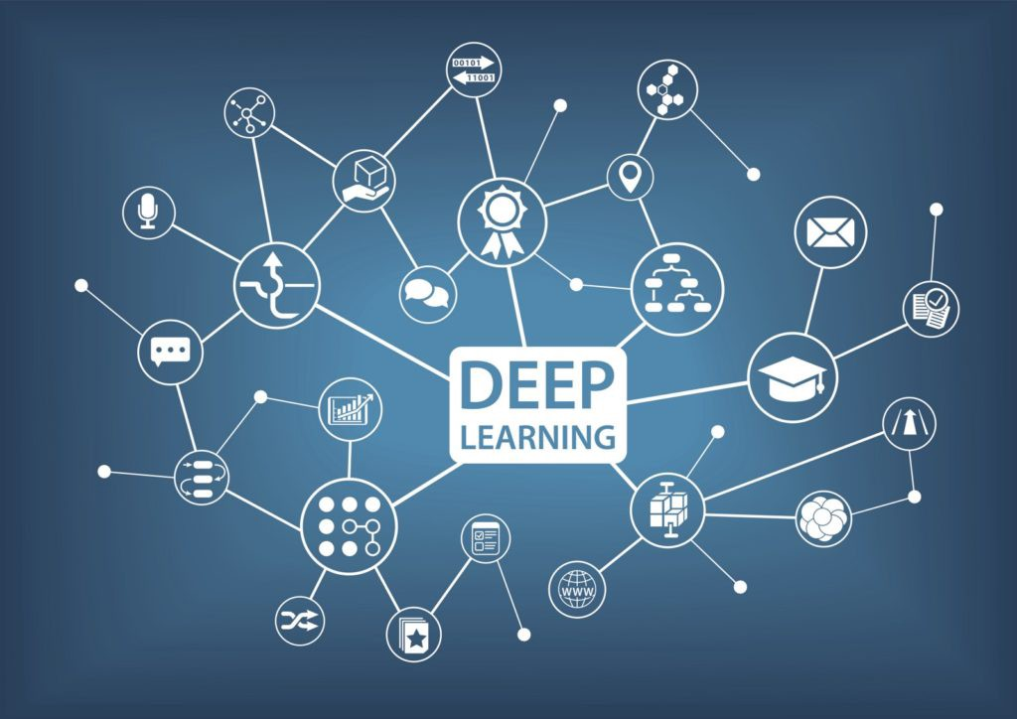
Deep Learning
Welcome to the minor!
Vera Hollink
2025

Slide 2
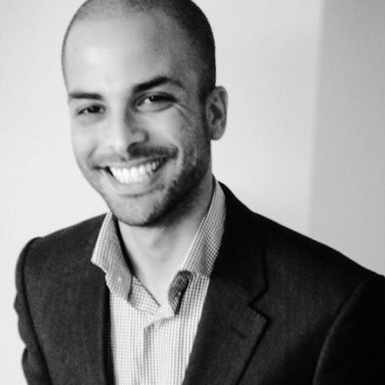
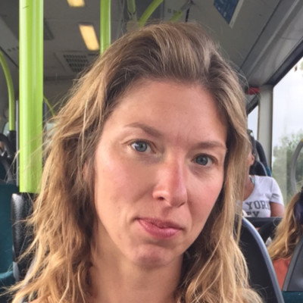

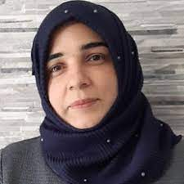
Lecturers
Youssef En-nali
Vera Hollink
Stijn Oomes
Marya Butt

Slide 3
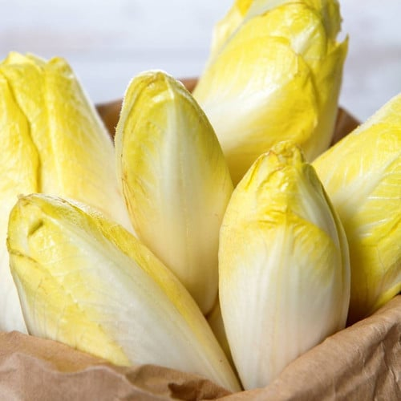

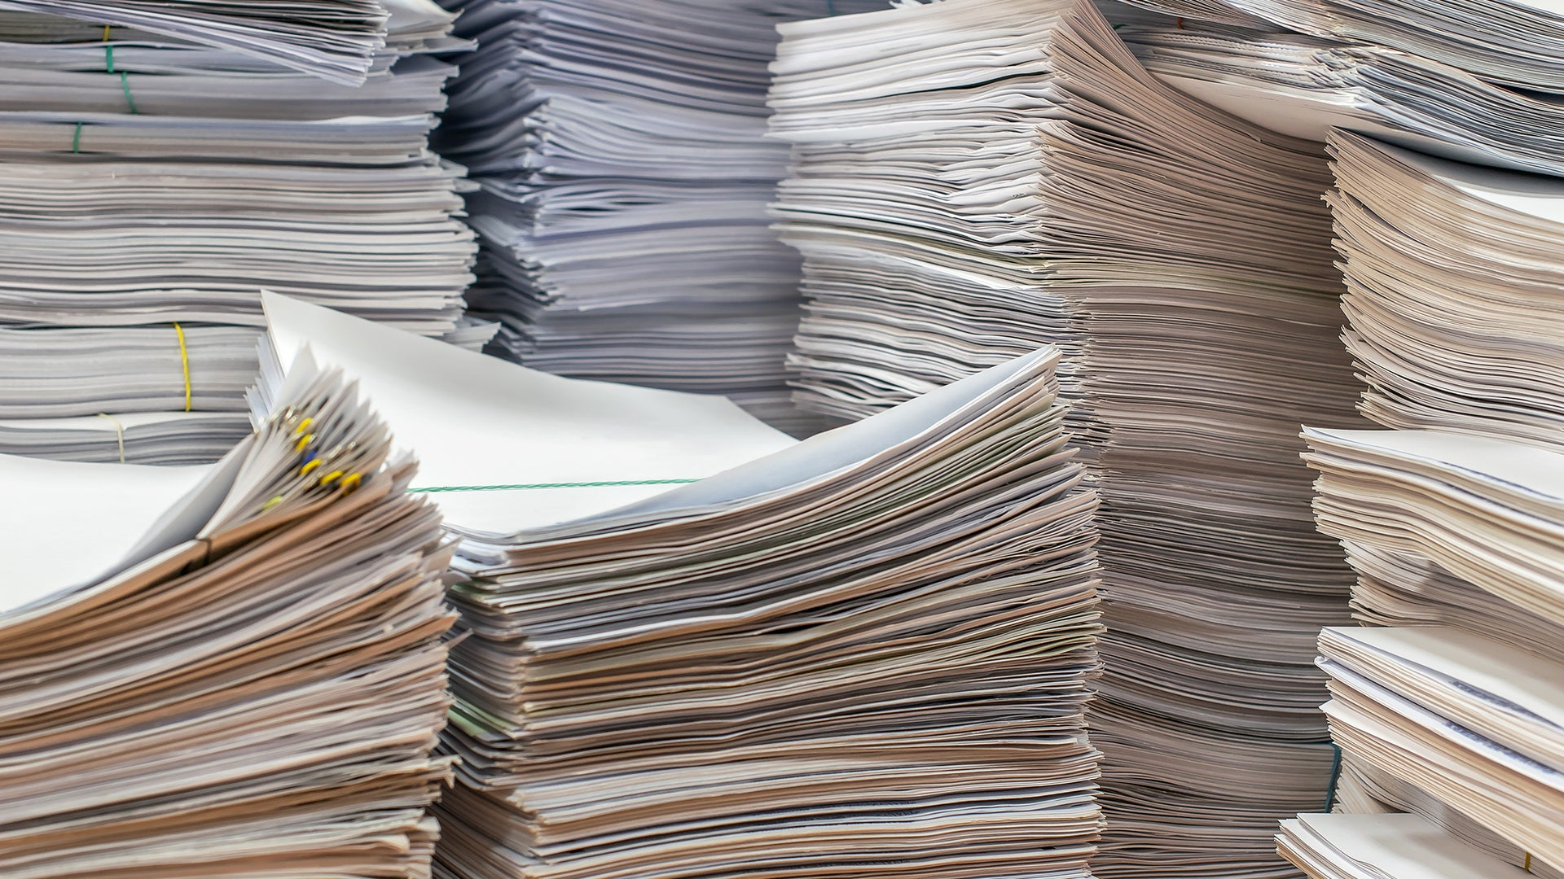
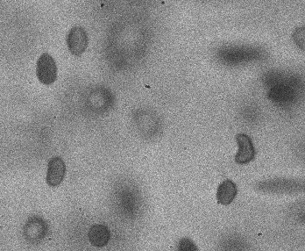
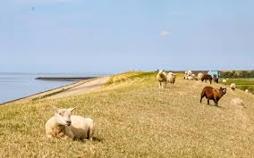
Course structure
Term 3
Foundational theory
Assignments
Term 4
Advanced theory
Student presentations
Deep Learning Project

Slide 4

Schedule
Lectures and labs
Tuesdays & Thursday
Self study
Monday, Wednesday, Friday
Exact schedule in the course guide

Slide 5

Moodle
Course AM - 3.3 - Deep Learning
Self enrollment
Course guide
Slides
Assignments
Hand in your work
Project materials

Slide 6
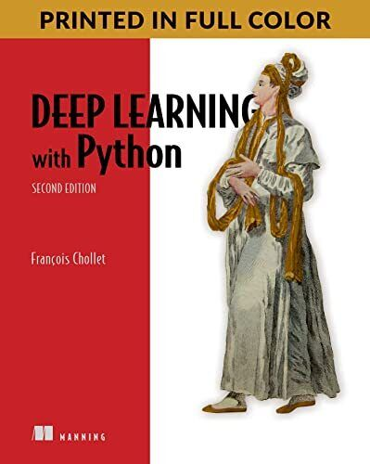
Literature
Deep Learning with Python, 2nd edition
François Chollet, 2021
ISBN 9781617296864

Slide 7
Assessment
Foundations of Deep Learning - Exam
4 EC end of term 4
multiple choice exam
Foundations of Deep Learning - Assignments
8 EC during term 3
3 assignments (average grade)
Applications of Deep Learning - Presentations
3 EC during term 4
student presents a paper
Deep Learning in action
15 EC during term 4
group project

Slide 8
This week
Lectures deep learning
Introduction to deep learning – Youssef
Data mining workflow and applications – Youssef
Supporting lectures and labs
Derivatives – Frank Brandse
Matrix calculation and numpy – Stijn Oomes
Lab environment setup – Stijn Oomes

Slide 9
Contact information
Vera Hollink – minor coordinator
Vera.hollink@inholland.nl
06-621115349
Marya Butt - projects
Marya.Butt@inholland.nl
Youssef En-nali
Youssef.Ennali@inholland.nl
Stijn Oomes – Labs and assignments
Stijn.Oomes@inholland.nl

Slide 10

Welcome everyone!

